Slide 1





Fake Google Login
Implement with Ettercap DNS spoofing and SEToolkit
N26090685 陶俊穎
N26092043 洪翊珈

Slide 2
Index
Introduction
Workflow
Background
Nmap
Ettercap
Social Engineering Toolkit
Demo
Conclusion

Slide 3



1.
Introduction

Slide 4
Introduction
Social engineering attacks are always been a serious threat to the world of internet and user.
By Cisco website’s article, it is still considering the most common cyber attack method these days.

Slide 5
Common types of cyber attacks
Malware
malicious software, including spyware, ransomware, viruses, and worms.
Phishing
sending fraudulent communications that appear to come from a reputable source
Man-in-the-middle
attackers insert themselves into a two-party transaction
Denial-of-service
floods systems, servers, or networks with traffic to exhaust resources and bandwidth
SQL injection
inserts malicious code into a server that uses SQL and forces the server to reveal information it normally would not.
Zero-day exploit
A zero-day exploit hits after a network vulnerability is announced but before a patch or solution is implemented.
https://www.cisco.com/c/en/us/products/security/common-cyberattacks.html#~how-cyber-attacks-work

Slide 6
Project goal
To present how to launch a basic social engineering attack
Combined some web attack technique eg, mitm, DNS spoofed…

Slide 7
2.
Workflow

Slide 8
Workflow
Using Nmap finding victim and default router
ARP spoofing the victim and default router
Setup Ettercap redirect table for DNS spoofing
Lure victim to fake google login page
Harvest credential data

Slide 9







Using Nmap finding victim and default router
Recon
Potential Victim

Slide 10
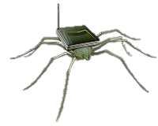
ARP spoofing the victim and default router
ARP spoofing
Ettercap
Potential Victim

Slide 11
Setup Ettercap redirect table
DNS Query
Ettercap
www.google.com -> hacker IP
*google.com -> hacker IP

Slide 12
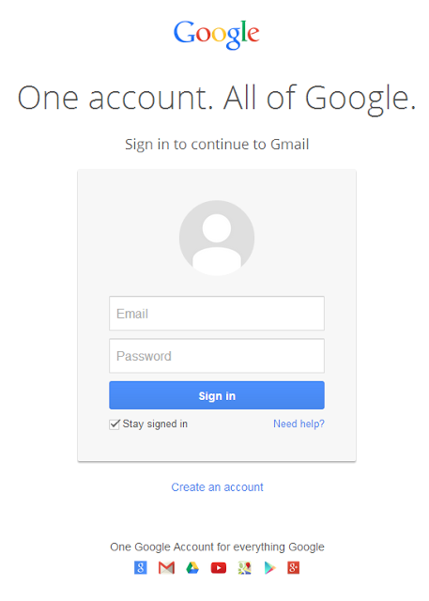

Lure victim to fake google login page

Slide 13
Harvest credential data
Logging credential data

Slide 14
3.
Background

Slide 15

Social Engineering
The psychological manipulation of people into performing actions or divulging confidential information.

Slide 16
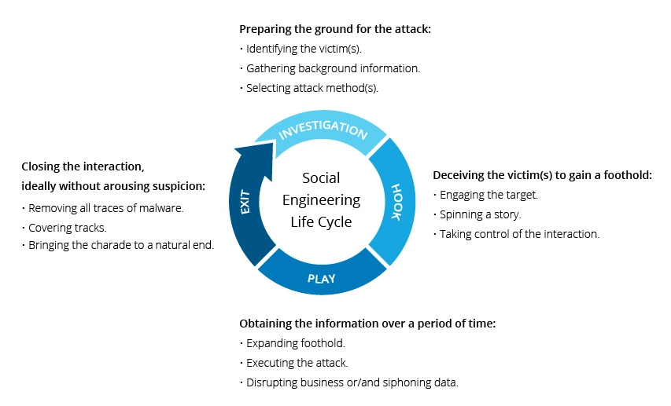
Social Engineering

Slide 17


DNS Spoofing
sus
DNS
a form of computer security hacking in which corrupt DNS data is introduced into the DNS resolver

Slide 18
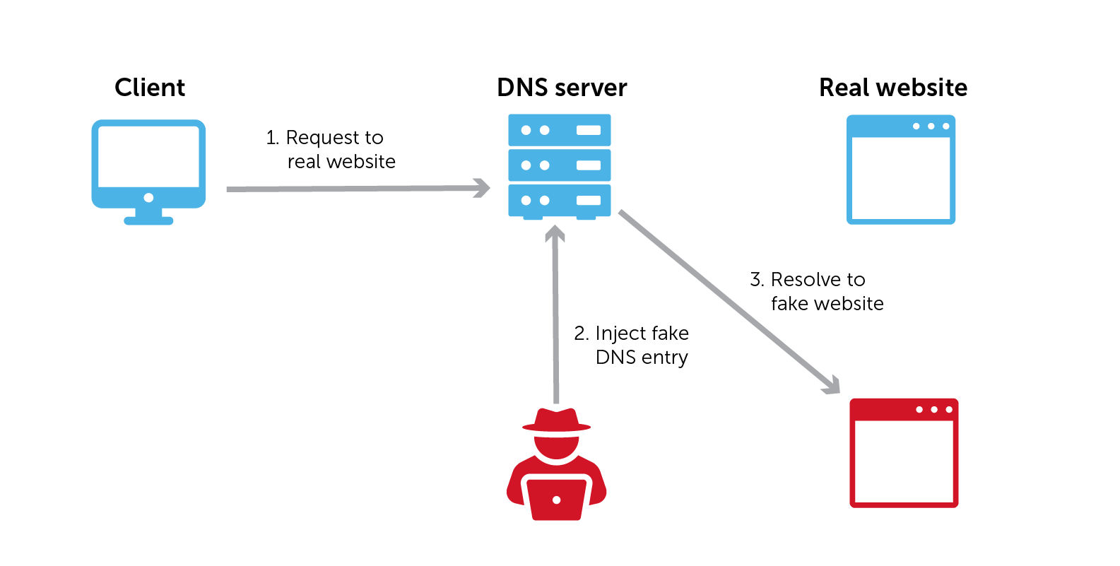
DNS Spoofing

Slide 19






DNS Spoofing variant – DNS Hijacking

Slide 20
4.
Nmap

Slide 21
Nmap
Nmap is used to discover hosts and services on a computer network by sending packets and analyzing the responses.

Slide 22
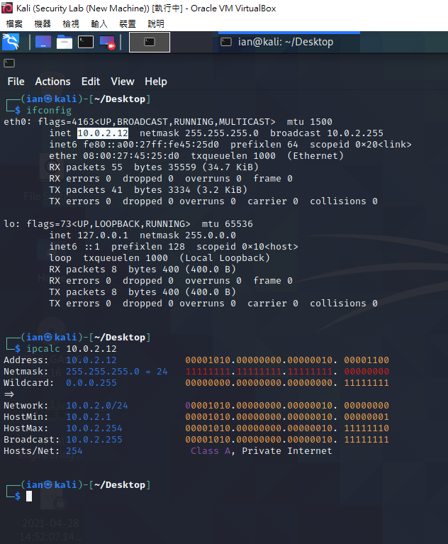
Pre-setup
$ifconfig – get self IP address

Slide 23
Pre-setup
$ipcalc

Slide 24
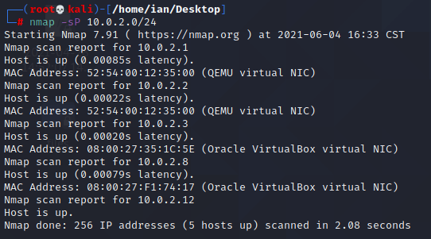
Finding potential target
$nmap –sP 10.0.2.0/24
Notes:
偵測有開機的主機

Slide 25
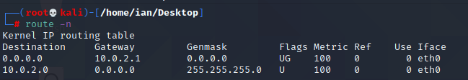
Finding default router
$route -n

Slide 26
5.
Ettercap

Slide 27


Ettercap
Ettercap is a comprehensive suite for man in the middle attacks. It contain varies of attack vector and lots of plugin module.

Slide 28
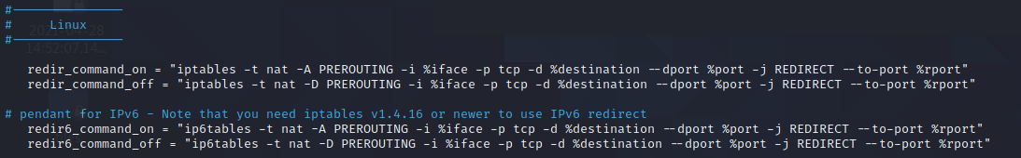
Pre-setup
$nano /etc/Ettercap/etter.conf

Slide 29
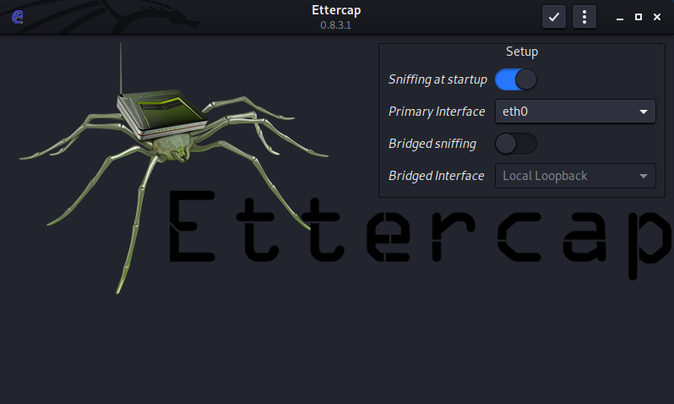
Ettercap
$sudo ettercap -G

Slide 30
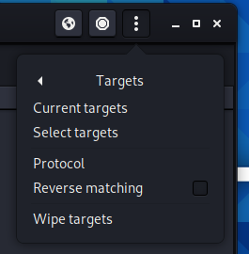
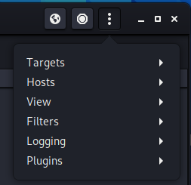
Setup target

Slide 31
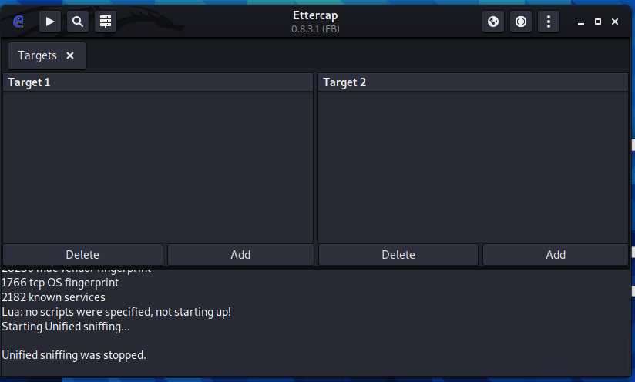
Setup target

Slide 32
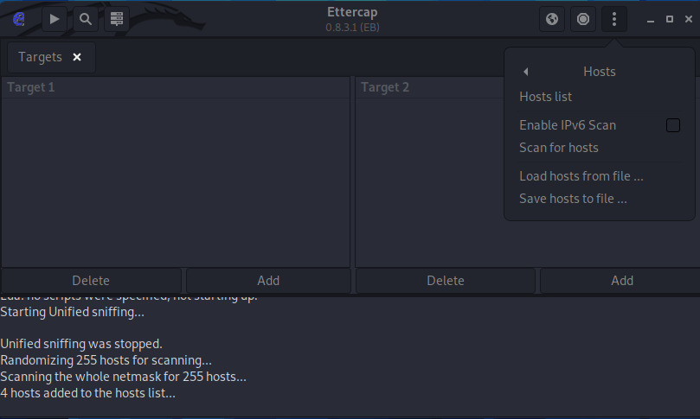
Setup target

Slide 33
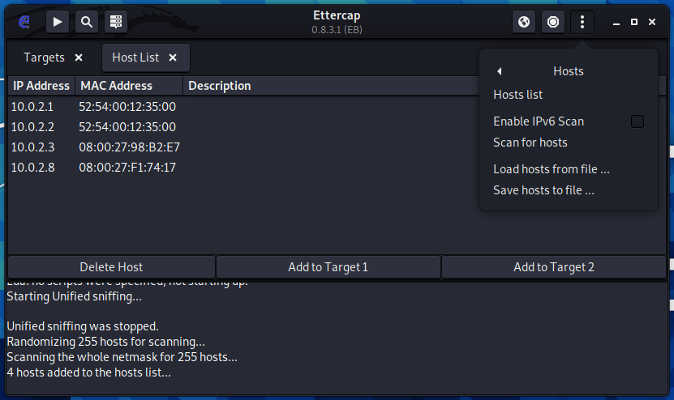
Setup target

Slide 34
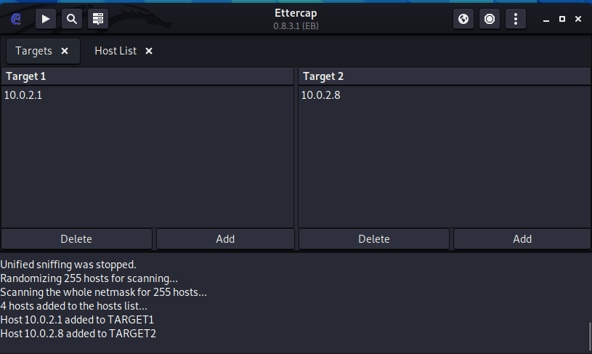
Setup target

Slide 35
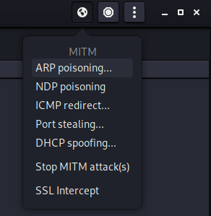
ARP Spoofing

Slide 36
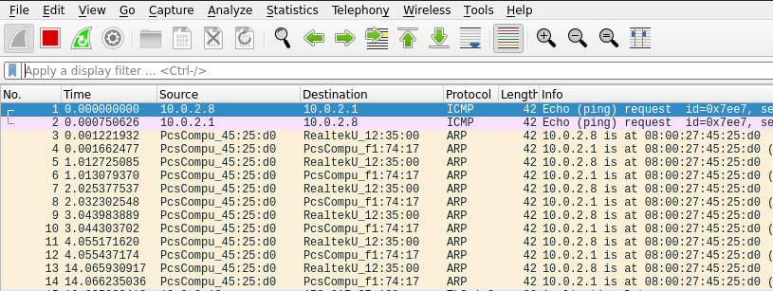
View from Wireshark

Slide 37
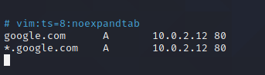
Setting redirect table
$ nano /etc/ettercap/etter.dns

Slide 38
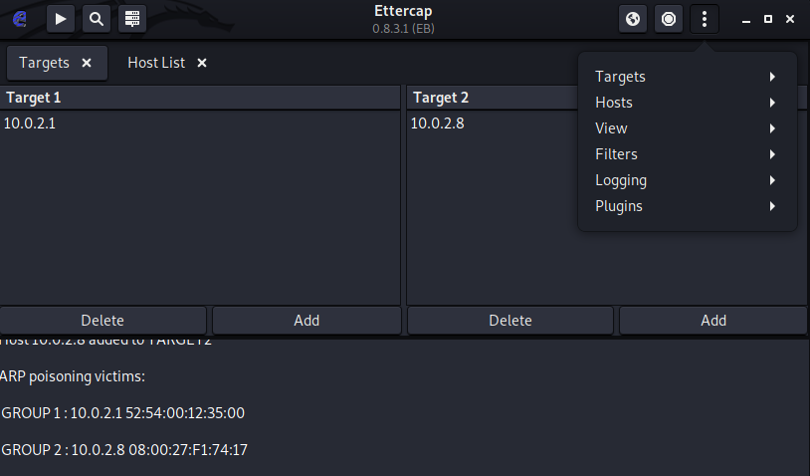
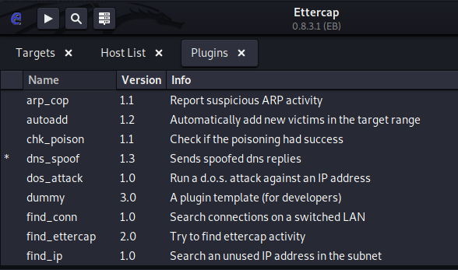
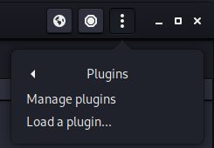
Activate DNS spoofing plugin

Slide 39
6.
Social Enginnering Toolkit

Slide 40

SEToolkit
The Social-Engineer Toolkit is an open-source penetration testing framework designed for social engineering.
Download Link: https://github.com/trustedsec/social-engineer-toolkit

Slide 41
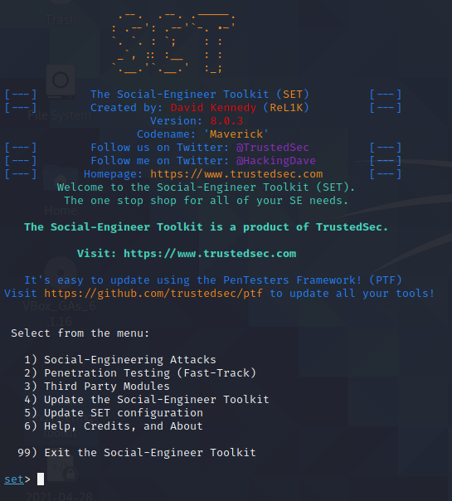
Setting up fake website

Slide 42
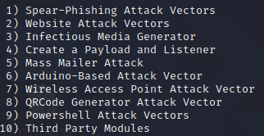
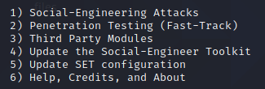
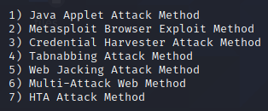
Setting up fake website
1) Social-Engineering Attacks
2) Website Attack Vectors
3) Credential Harvester Attack Method

Slide 43
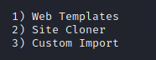
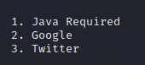
Setting up fake website
1) Web Templates
2. Google

Slide 44
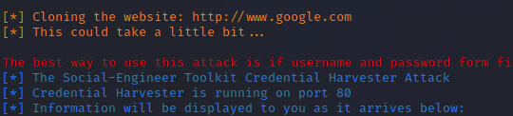
Setting up fake website

Slide 45
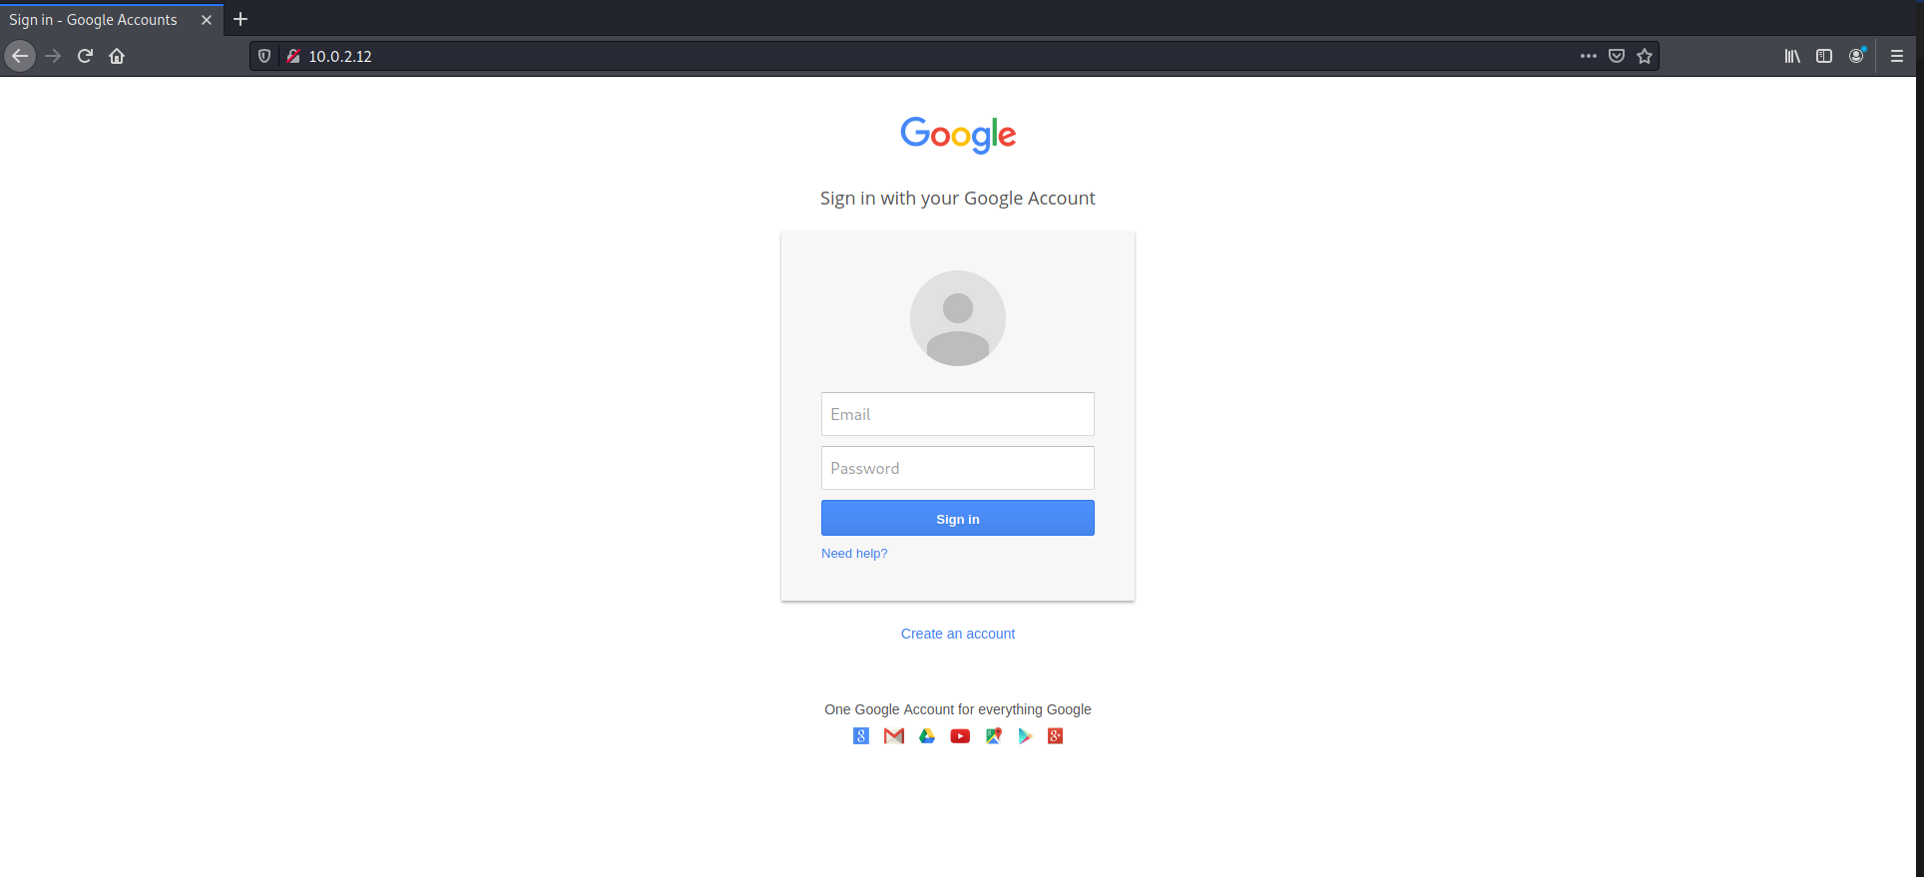
Setting up fake website

Slide 46
7. Demo

Slide 47
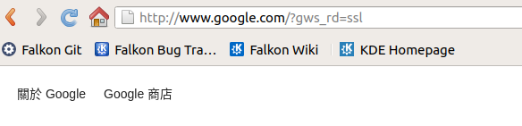
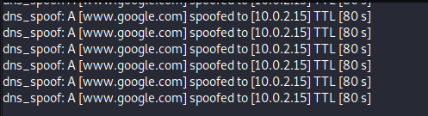
Victim go to google.com

Slide 48
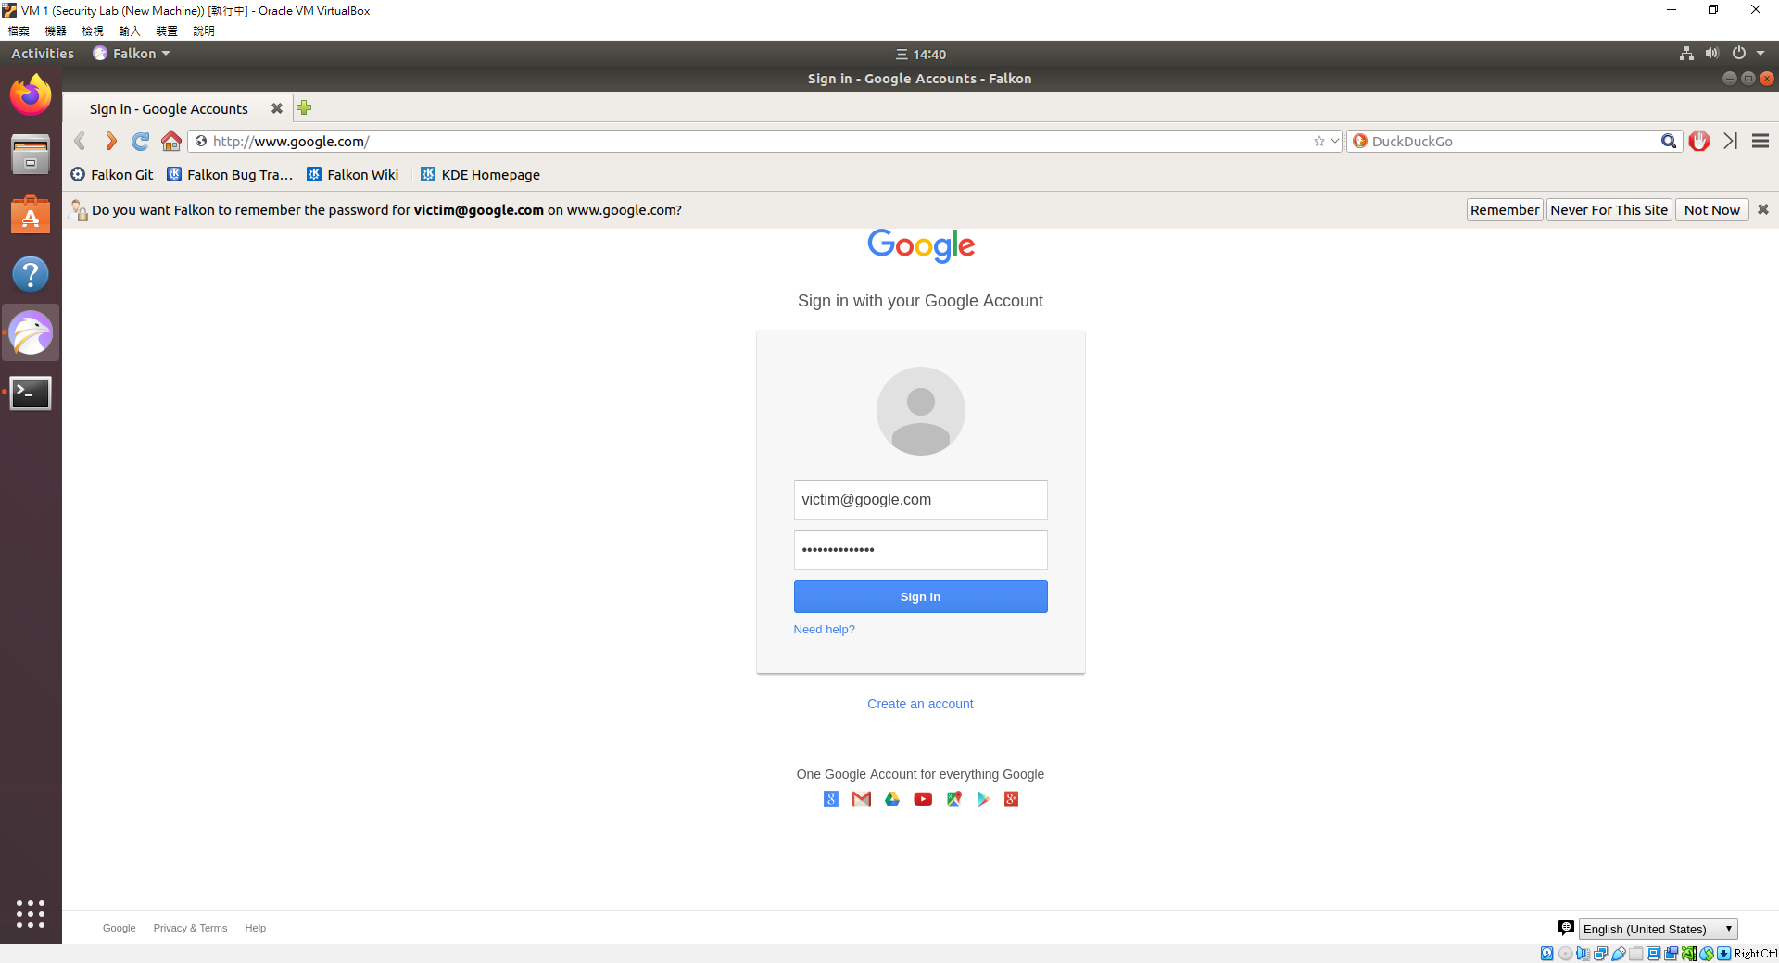
Logging from victim side

Slide 49
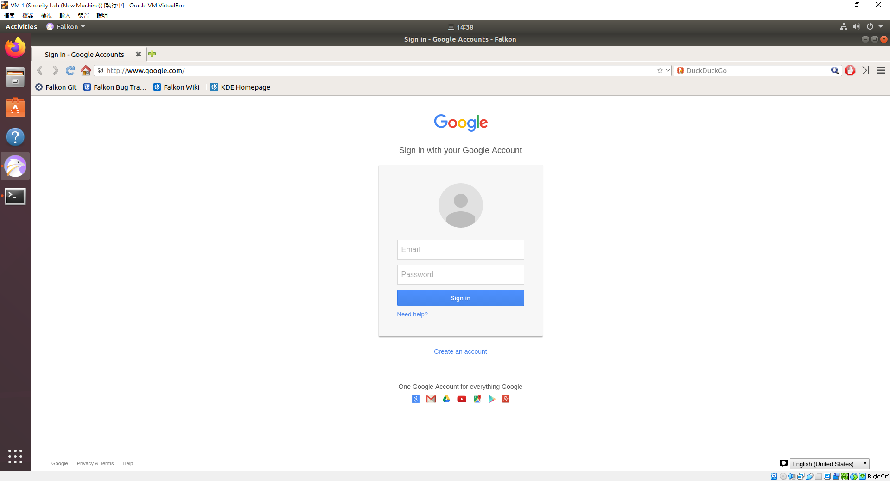
After logging

Slide 50
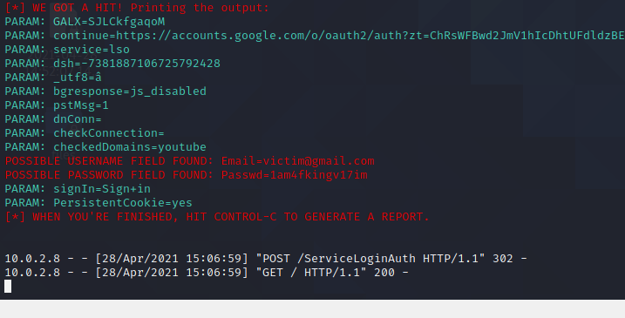
Credential harvesting

Slide 51
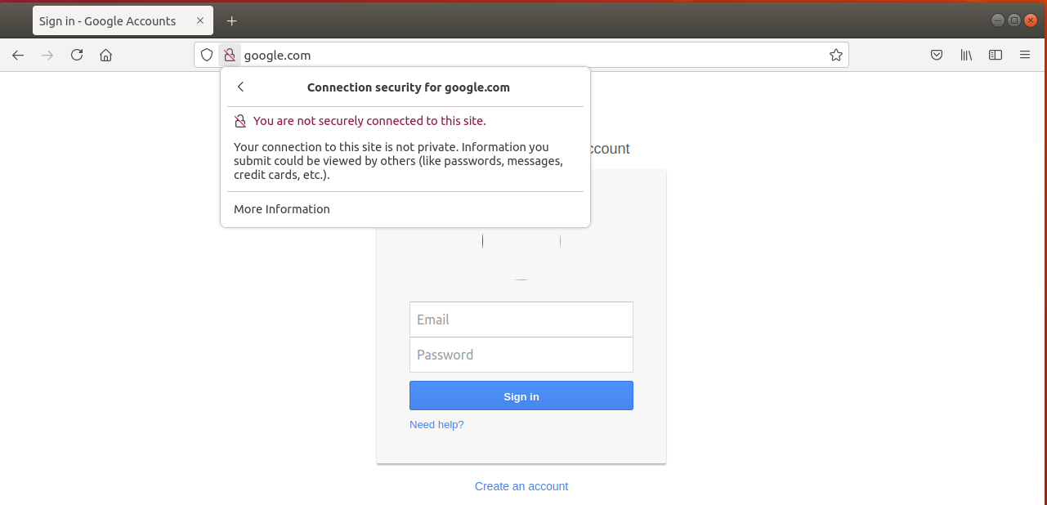
Not secure connection

Slide 52
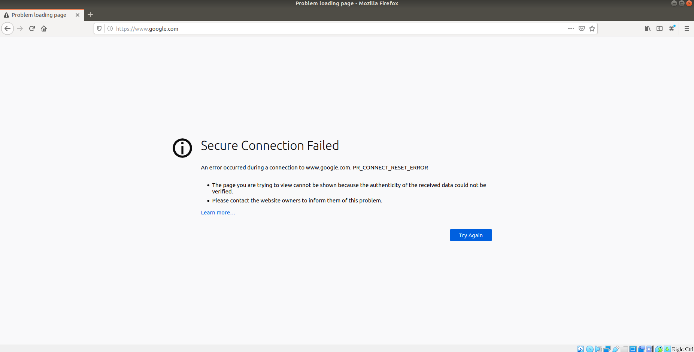
Secure connection

Slide 53
8. Conclusion

Slide 54
Conclusion
We demonstrate a procedure to launch a SE attack from scratch
We successfully get the victim’s credential data
As the result, our computer can be vulnerable if it is exposed under a dangerous environment.

Slide 55
Conclusion
How to prevent?
Do not connect untrusted network.
Do not use outdated internet explorer.
Always use HTTPS protocol.

Slide 56

Team member
陶俊穎
Project design, implementation
洪翊珈
Survey, Document arranging
IMS Lab

Slide 57

Thanks!
Any questions?
You can find me at:
@je_suis_ian199833
taochungying@gmail.com

Slide 58
Credits
Special thanks to all the people who made and released these awesome resources for free:
Presentation template by SlidesCarnival
Photographs by Unsplash

